Slide 1
Coronavirus Disease 2019 (COVID-19)
COVID-19 is an emerging, rapidly evolving situation. The information provided in this power point is based on current guidance and is subject to change. (Created 3-6-2020)

Slide 2
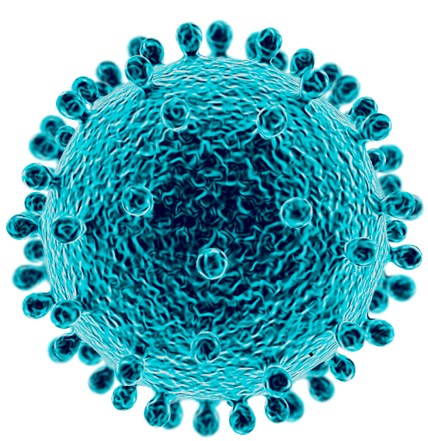
What Do We Know About Coronaviruses?
Coronaviruses are a large family of viruses - some cause illness in people, and others only infect animals.
Some coronaviruses infect animals then spread to people, and then spread person to person such as:
Middle East Respiratory Syndrome (MERS)
Severe Acute Respiratory Syndrome (SARS)
Coronavirus Disease 2019 (COVID-19)
Common coronaviruses include some that cause mild upper-respiratory illnesses, like the common cold.
Coronaviruses have a crown-like appearance under the microscope

Slide 3
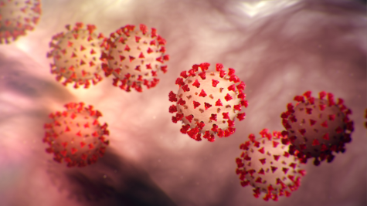
What is COVID-19?
Coronavirus disease 2019 or COVID-19 is a respiratory illness that can spread from person to person.
The virus that causes COVID-19 is a new coronavirus first identified during an investigation into an outbreak in Wuhan, Hubei Province, China.
Initial case-patients reported visiting a large seafood and live animal market in Wuhan.

Slide 4
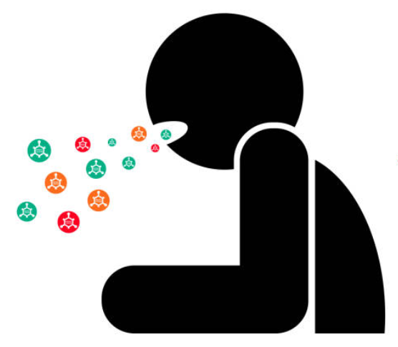
How Does COVID-19 Spread?
COVID-19 spreads the same way the flu and other respiratory diseases spread:
Through respiratory droplets produced when an infected person coughs or sneezes.
These droplets can land in the mouths or noses of people who are nearby or possibly be inhaled into the lungs.
Between people who are in close contact with one another (within about 6 feet).

Slide 5
What are the Symptoms of COVID-19?
Symptoms of COVID-19 are:
Fever
Cough
Shortness of breath
Symptoms appear 2 to 14 days after exposure. The average incubation period of COVID-19 is reported to be about 5 days.
Eighty percent of patients with confirmed COVID-19 have mild symptoms.
In very severe cases, patients with COVID-19 have developed pneumonia in both lungs. In some cases, COVID-19 can be fatal.

Slide 6
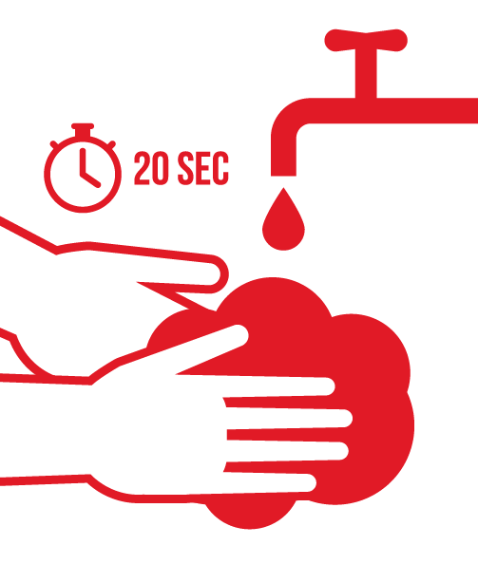
How Can COVID-19 Infection be Prevented?
Wash your hands often with soap and warm water for at least 20 seconds - use an alcohol-based hand sanitizer if soap and water are not available.
Avoid touching your eyes, nose and mouth with unwashed hands.
Cover your cough or sneeze with a tissue, then throw the tissue in the trash.
Stay home if you’re sick.
Avoid close contact with people who are sick.
Get a flu shot! A flu shot won’t protect against COVID-19, but if you do get the flu, your symptoms will be less severe, easing the burden on health care facilities.
Sing “Happy Birthday” two times through as you’re washing.
Notes:
There is no vaccine to prevent COVID-19.
The best way to prevent infection is to avoid being exposed to the virus that causes COVID-19.
The same measures urged to prevent the spread of any respiratory virus are increasingly important for all Georgians.
A flu shot will not protect against COVID-19, but it will help keep people with flu complications out of the hospital so the health care system does not become overburdened in the event of a COVID-19 outbreak.

Slide 7
Where Have Your Hands Been?
Notes:
ATM
Gym Equipment
Menus
Hand railings
Touch screens
Public transportation
Gas pumps
Shopping carts
Elevator buttons
Meeting room desks and chairs
Money

Slide 8
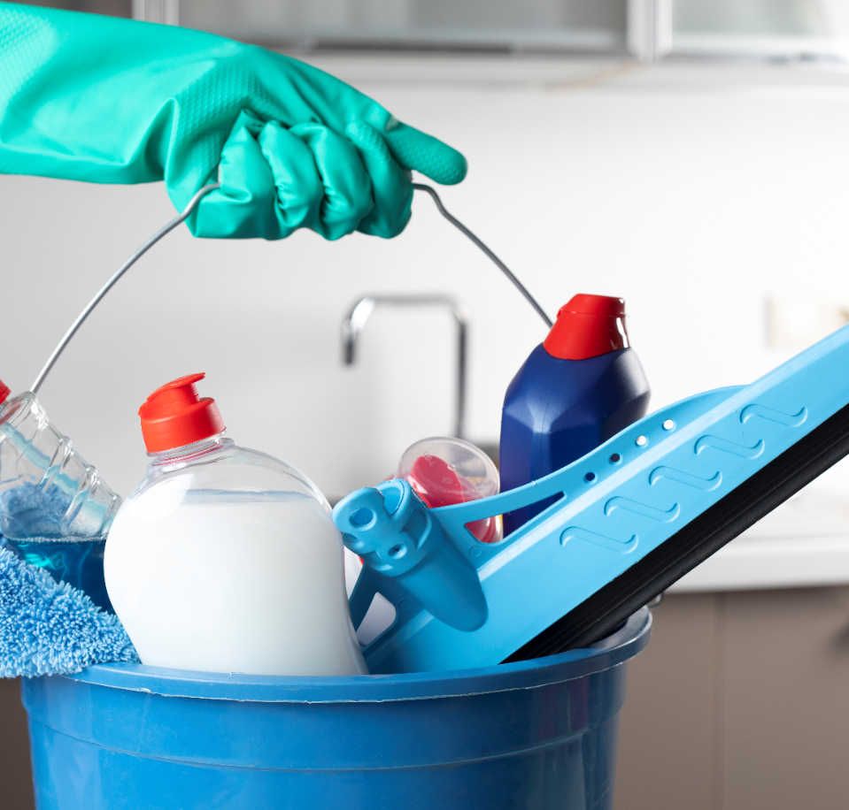
How Can COVID-19 Infection be Prevented?
Clean frequently touched surfaces and objects daily (e.g., tables, countertops, light switches, doorknobs, cabinet handles) using regular household cleaning products and water.
Clean your electronic devices (phones, tablets, laptops, keyboards) with approved wipes or cleaning products.
Always follow the manufacturer’s instructions for all cleaning and disinfection products.

Slide 9
Should I Be Tested for COVID-19?
Call your healthcare provider if:
You feel sick with fever, cough or difficulty breathing.
You have been in close contact with a person known to have COVID-19.
You recently traveled from an area with ongoing spread of COVID-19.
Your healthcare provider will work with Public Health to determine if you need to be tested for COVID-19.
People who think they may have been exposed to COVID-19 must call their healthcare provider before going to a provider’s office, emergency department or urgent care.

Slide 10
What Do All These Things Mean?
Community spread means people have been infected with the virus in an area, including some who are not sure how or where they became infected.
Social distancing means remaining out of congregate settings, avoiding local public transportation (e.g., bus, trains, ride share), and maintaining distance (approximately 6 feet) from others.
Congregate settings are public places where close contact with others may occur, such as shopping centers, theaters, stadiums, workplaces and schools.
Incubation period refers to the time from exposure to an infection to the onset of symptoms. Different diseases have different incubation periods.
Isolation separates those with who are sick with a contagious disease from those who are not to avoid transmission.
Quarantine separates and restricts movement of people who may have been exposed to a contagious disease, but do not show symptoms.
Epidemic is a rapid increase in the number of cases of a disease above what is normally expected in a specific population.
Pandemic refers to a global epidemic or one that has spread over several countries or continents, affecting many people.
Outbreak carries the same definition as epidemic, but it is used for a more limited geographic area.

Slide 11
Preparing Your Household for a COVID-19 Outbreak
Keep an adequate supply of water, food and pet food in your home. If you take prescription drugs, contact your health care provider about keeping an emergency supply at home.
Meet with family, relatives, and friends to discuss possible needs in the event of an infectious disease outbreak.
Join neighborhood information webpages or emails.
Plan ways to care for people at higher risk - the very young, older people, people with chronic diseases or compromised immune systems.
https://www.cdc.gov/coronavirus/2019-ncov/community/schools-childcare/guidance-for-schools.html?CDC_AA_refVal=https%3A%2F%2Fwww.cdc.gov%2Fcoronavirus%2F2019-ncov%2Fspecific-groups%2Fguidance-for-schools.html
Choose a room in your home that could be used to separate family members who become sick.
Create an emergency contact list of family members, friends, neighbors, health care providers, teachers, employers and others.
Keep a working thermometer and medications, like decongestants, expectorants and ibuprofen or acetaminophen on hand.
Know the preparedness plans of your children’s childcare, schools and/or colleges.
Plan for childcare should schools temporarily close.
Ask about your employers’ preparedness plans, including sick-leave policies and telework options.

Slide 12
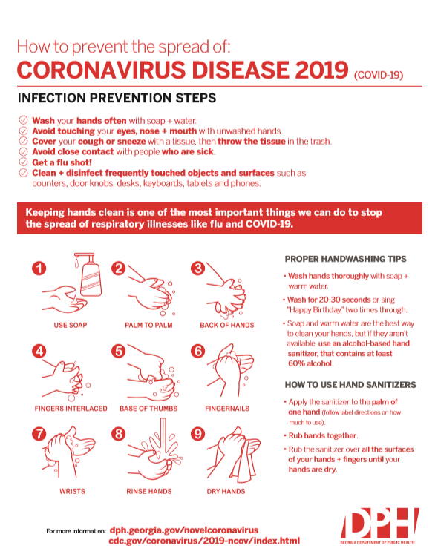
Preparing Schools for Outbreaks of COVID-19
Review, update and implement emergency operations plans.
Communicate with school staff and parents about measures to prevent illness – flu shots, handwashing, covering coughs and sneezes with a tissue, stay home if you’re sick.
Monitor and plan for absenteeism – students, faculty and staff. What level of absenteeism will disrupt teaching and learning, as well as ensuring a safe environment for students and staff?
Establish procedures for students and staff who become sick at school or arrive to school sick.
Continue to perform routine environmental cleaning, including frequently touched surfaces, desks, keyboards and tablets.
https://www.cdc.gov/coronavirus/2019-ncov/community/schools-childcare/guidance-for-schools.html?CDC_AA_refVal=https%3A%2F%2Fwww.cdc.gov%2Fcoronavirus%2F2019-ncov%2Fspecific-groups%2Fguidance-for-schools.html

Slide 13
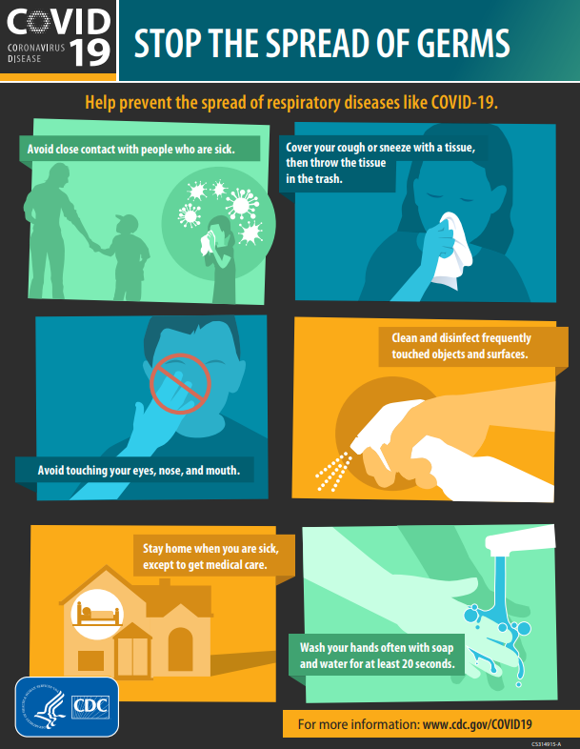
Preparing Businesses for Outbreaks of Covid-19
Have a plan to continue your essential business functions.
Cross-train personnel to perform essential functions so that the work can continue if key staff members are absent.
Develop guidelines for employees to telework.
Assess your essential functions and the reliance that the community has on your services or products.
Encourage sick employees to stay home.
Reinforce healthy behaviors such as handwashing with soap and water, covering a cough or sneeze with a tissue, get a flu shot.
Provide soap and water and alcohol-based hand rubs in the workplace.
Monitor for and discourage stigma and discrimination in the workplace.
https://www.cdc.gov/coronavirus/2019-ncov/community/guidance-business-response.html?CDC_AA_refVal=https%3A%2F%2Fwww.cdc.gov%2Fcoronavirus%2F2019-ncov%2Fspecific-groups%2Fguidance-business-response.html

Slide 14
Preparing for Community Mass Gatherings
Meet with the emergency operations coordinators or planning teams at your venues.
Establish relationships with key community partners and stakeholders.
Provide COVID-19 prevention supplies at your events, including sinks with soap, hand sanitizers, and tissues.
Identify actions to take should you need to postpone or cancel events.
Update and distribute timely and accurate emergency COVID-19 information.
Promote messages that discourage people who are sick from attending events.
https://www.cdc.gov/coronavirus/2019-ncov/community/large-events/mass-gatherings-ready-for-covid-19.html?CDC_AA_refVal=https%3A%2F%2Fwww.cdc.gov%2Fcoronavirus%2F2019-ncov%2Fcommunity%2Fmass-gatherings-ready-for-covid-19.html

Slide 15
COVID-19 and Stigma
Diseases can make anyone sick regardless
of their race or ethnicity or where they live!
People of Asian descent, including Chinese Americans, are not more likely to get COVID-19 than any other American.
Stopping stigma can help communities withstand or recover quickly from difficult situations, such as disease outbreaks.
Communicating the facts that viruses do not target specific racial or ethnic groups, and how COVID-19 spreads can help stop stigma.
Notes:
People in the U.S. may be worried or anxious about friends and relatives who are living in or visiting areas where COVID-19 is spreading. Some people are worried about the disease. Fear and anxiety can lead to social stigma, for example, towards Chinese or other Asian Americans or people who were in quarantine.

Slide 16
COVID-19 FAQ
Is there a vaccine, drug or treatment for COVID-19?
To date, there is no vaccine and no specific antiviral medicine to prevent or treat COVID-2019. However, those affected should receive care to relieve symptoms. People with serious illness should be hospitalized.
Should I wear a mask to protect myself?
Only wear a mask if you are ill with COVID-19 symptoms (especially coughing) or looking after someone who may have COVID-19.
What about travel?
CDC provides recommendations on postponing or canceling travel through travel notices. Travel notices are based on assessment of the potential health risks involved with traveling to a certain area. No matter where you travel or how you travel, be aware of the COVID-19 situation at your destination and practice infection prevention: wash your hands, stay away from people who are sick, cover your cough or sneeze with a tissue, don’t touch your face with unwashed hands.
Can I get COVID-19 on an airplane?
Because of how air circulates and is filtered on airplanes, most viruses and other germs do not spread easily on airplanes. Although the risk of infection on an airplane is low, travelers should try to avoid contact with sick passengers and wash their hands often with soap and water or use hand sanitizer containing at least 60% alcohol.
Am I at risk for COVID-19 from a package or products shipped from China?
Currently there is no evidence to support transmission of COVID-19 associated with imported goods and there have not been any cases of COVID-19 in the United States associated with imported goods.

Slide 17
COVID-19 FAQ
How long does the virus survive on surfaces?
It is not certain how long the virus that causes COVID-19 survives on surfaces. Studies suggest that coronaviruses (including the COVID-19 virus) may survive on surfaces for a few hours or up to several days. If you think a surface may be infected, clean it with simple disinfectant to kill the virus and protect yourself and others.
Can I catch COVID-19 from my pet?
No. There is no evidence that companion animals or pets such as cats and dogs have been infected or could spread the virus that causes COVID-19.
Who is at risk of developing severe illness?
While we are still learning about how COVID-2019 affects people, older persons and persons with pre-existing medical conditions (such as high blood pressure, heart disease, lung disease, cancer or diabetes) appear to develop serious illness more often than others.
Will the flu shot prevent COVID-19?
No, the flu shot won’t protect against COVID-19, but it can help protect against serious flu complications or lessen symptoms if you get it, lessening the strain on health care facilities.
Can I get COVID-19 from Corona beer?
No, you can’t get COVID-19 from Corona beer. Beer neither causes infection with a virus, and it does not cure it.
Can you get COVID-19 if you eat at Chinese restaurants in the U.S.?
No, you can’t get COVID-19 eating in a Chinese restaurant.

Slide 18
Last Thoughts
Stay calm and be prepared.
Get your information from reliable and accurate sources rather than to buying into hype and misinformation.
https://dph.georgia.gov/
https://www.cdc.gov/
Be kind, staying mindful of actions that could perpetuate discrimination or stigma associated with COVID-19 or other infectious diseases.
Prevention, not panic!

